Slide 1
Adequate Shelter for People Experiencing Homelessness Across Durham Region
October 2023

Slide 2
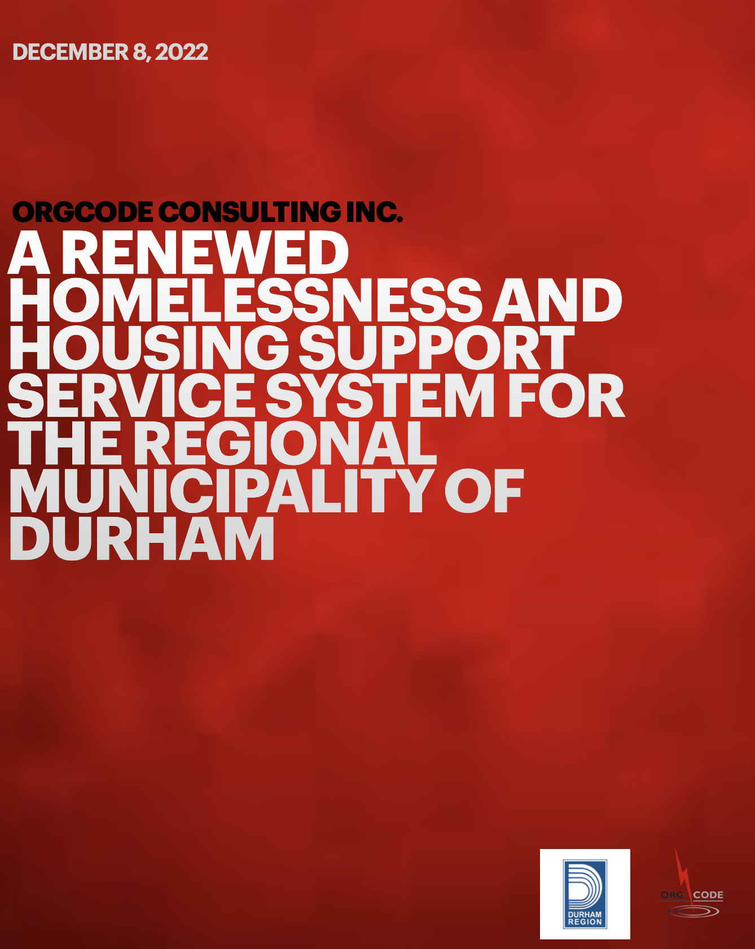
An extensive review of the homelessness and housing support system conducted by OrgCode Consulting Inc. in 2022 identified the need for at least 200 additional shelter beds by the end of 2026, with at least 140 of the beds located in Oshawa, Ajax, and/or, Whitby.

Slide 3
An open survey on homelessness and housing across Durham Region as part of the development of the report found that 78% of respondents indicated that shelter beds should be expanded throughout Durham Region.

Slide 4
Expansion of shelter services was supported by the steering committee and key informants, made up of representatives from non-profit organizations, health care providers, people with lived experience, law enforcement, and community volunteers.

Slide 5
Homelessness…
Occurs throughout the Region;
Is on the rise throughout Canada;
Impacts thousands of Canadians daily;
Can be solved through appropriate housing and professional supports;
Requires a high-functioning, evidence-informed system of care to get the best results;
Is well understood by staff and service providers across the Region because of the volume of data collected, participation in creating and using a By Name List, and various sector committees;
Is more often the fault of systems, not the fault of people;
Only happens to three types of people: someone’s parent; someone’s child; someone’s sibling.

Slide 6
What is a Shelter?
A shelter is emergency accommodation designed to meet the immediate needs of people experiencing homelessness, while at the same time focusing on helping the individual, couple and/or family realize permanent housing.
Shelters are voluntary. People experiencing homelessness cannot be forced to use shelter or to stay within a shelter 24 hours per day.
Across Canada there are more than 400 permanent homeless shelters providing more than 16,000 beds of service nightly.

Slide 7
What it Means to Be a Lower-Barrier Shelter
Lower-barrier shelters are the preferred approach to sheltering to ensure that the most vulnerable community members have a safe and appropriate place to sleep and access other services.
Lower-barrier does not mean there are no barriers. Some behaviours in shelter are never welcome:
  Violence or threats of violence;
  Sexual harassment or sexual violence;
  Theft;
  Excessive damage to property;
  Arson;
  Drug dealing.

Slide 8
Shelter Monitoring
Shelters are monitored on a regular basis by the Service Manager. The Service Manager examines things like:
  Assistance provided with income, vital documents, housing, mental health services, addiction services, health services, etc.;
  Turn-aways;
  Service restrictions and service bans;
  Bed utilization patterns;
  Unmet needs of the population served;
  Financial accountability;
  Data collection, privacy, and data security;
  Public Health matters (e.g., decrease disease transmission, safe food preparation, etc.);
  Adherence to shelter standards;
  Training of shelter staff;
  Quality and maintenance of the building;
  Critical incidents;
  Grievance policies and responses;
  Neighbour relations;
  Adherence to applicable legislation.

Slide 9
Shelters And the Relationship to the Broader Community
Shelters are operated by trained professionals who engage, serve, and, support people while using shelter.
People that use shelter are responsible for their own actions. However, a shelter can influence the relationship to the broader community through things like fencing and lighting, and informing shelter guests where to smoke and where to gather on property.
Many shelter providers have liaison committees for ongoing dialogue and problem-solving with businesses and housed residents within vicinity of the shelter.

Slide 10
Common Opposition to A New Shelter
While often grounded in myths, incomplete facts, opinions or lacking context, the common opposition positions related to shelter are:
  A belief it will increase crime;
  A belief that if children see homelessness it will have a negative impact on them;
  A belief it will erode property values;
  A belief it will be better in a different location;
  A belief it will increase drug use in the community;
  A belief that a different use for a building/property will be better suited to a different purpose/population;
  A belief it will attract people from far away and that people will be bussed in for services;
  A belief the shelter should screen potential shelter users and ensure none of them use drugs, live with mental illness, or have a history of conflict with the law.

Slide 11
The Relationship Between Shelters and Encampments In The Ontario Context
Earlier in 2023, the Ontario Superior Court Justice Valente ruled that Waterloo Region could not evict and dismantle an encampment on public property.
Succinctly, the Justice indicated that removing the encampment would be a violation of Charter Rights of the encampment residents. The Justice focused on the residents' rights to life, liberty, and security of the person because of the lack of shelter space. The shelter bed had to be operational, available for the specific population group seeking shelter, and accommodating for the individual seeking shelter.
The Justice determined shelter spaces must not split couples, must provide supports, must not “impose rules that cannot be followed due to addiction,” and must accommodate mental or physical disability.

Slide 12
Thank you!
idejong@orgcode.com

